Slide 1
CEIS110 Programming with Data Professor Dr. Sapijaszko Date 8/31/2024 By, April Wytaske

Slide 2
Introduction Data is growing worldwide. This project used a cloud-based system to gather temperature and humidity data. Then the data was analyzed using programming and data analyses.

Slide 3
Software Used
Replit
Python
Excel

Slide 4
Module 2
Flowchart
Noaa SDK installation

Slide 5
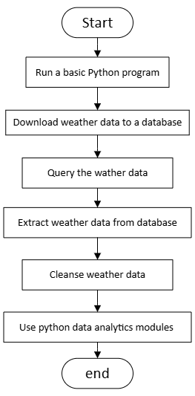
Flowchart
Include the following processes:
Run a basic python program
Download weather data to a database.
Query the weather data
Extract weather data from database into a comma separated file with python
Cleanse weather data
Use python data analytics modules to develop graphical models

Slide 6
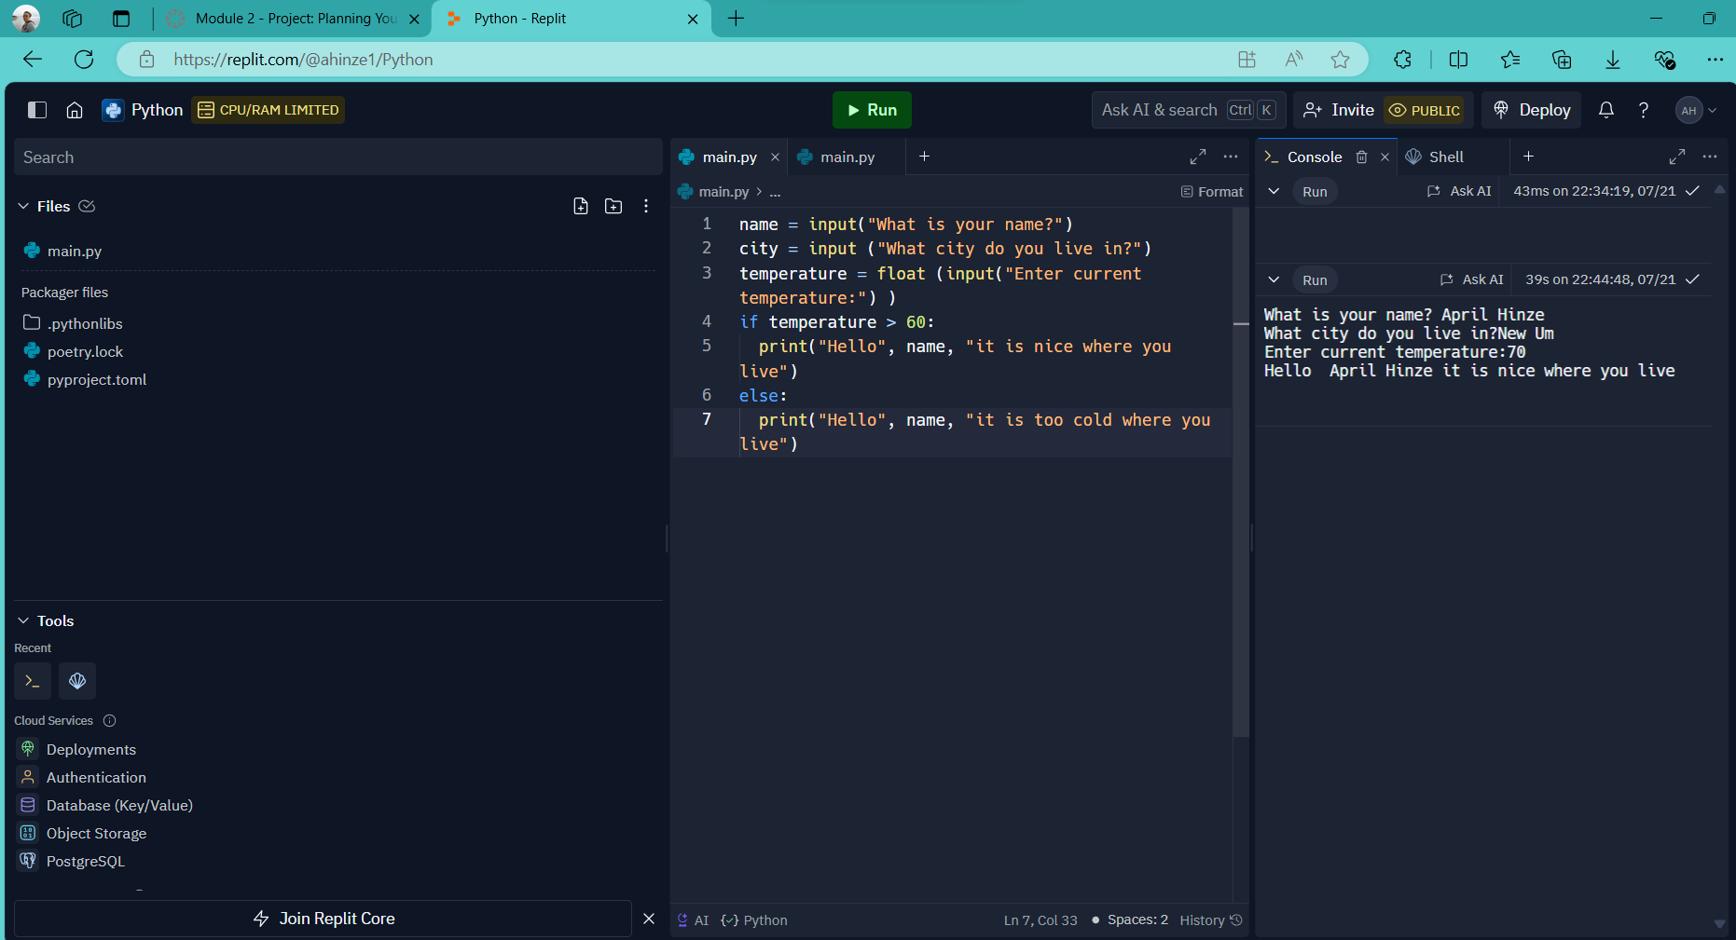
Python program (Screenshot)
Include screenshot of successful python program

Slide 7
Module 3
Downloaded weather data

Slide 8
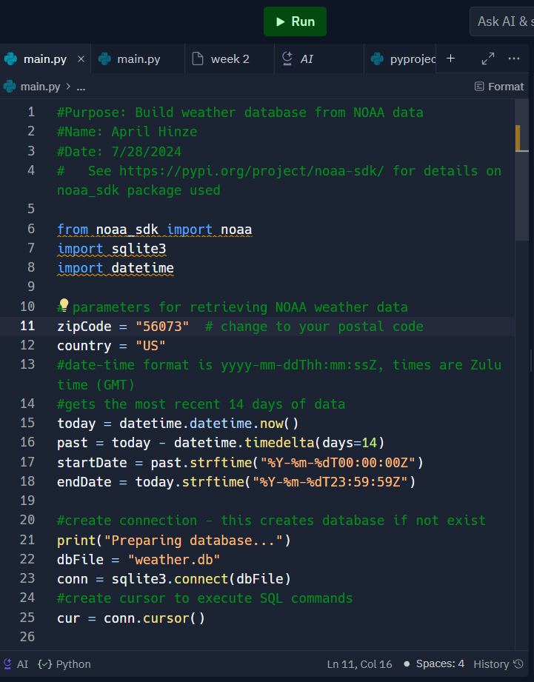
BuildWeatherDb.py Code (Screenshot)
Screenshot of code in Spyder
Must have your name and date in the comments
Must have your zip code

Slide 9
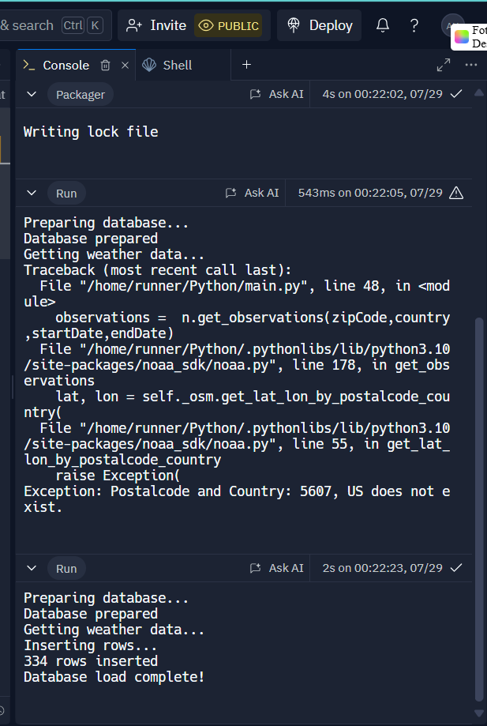
Python Console (Screenshot)
Screenshot of program output in Python console showing program executed successfully

Slide 10
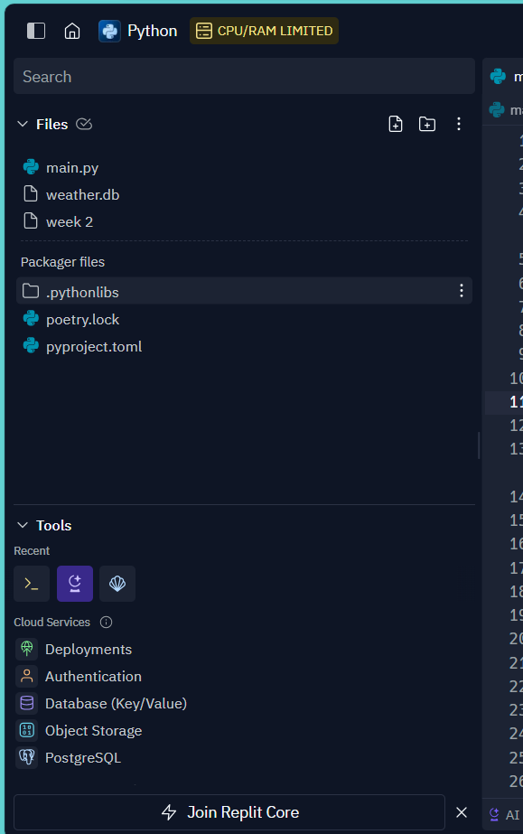
Weather.db File (Screenshot)
Screenshot of Windows Explorer showing database file Weather.db was created

Slide 11
Module 4
Querying Database with SQL

Slide 12
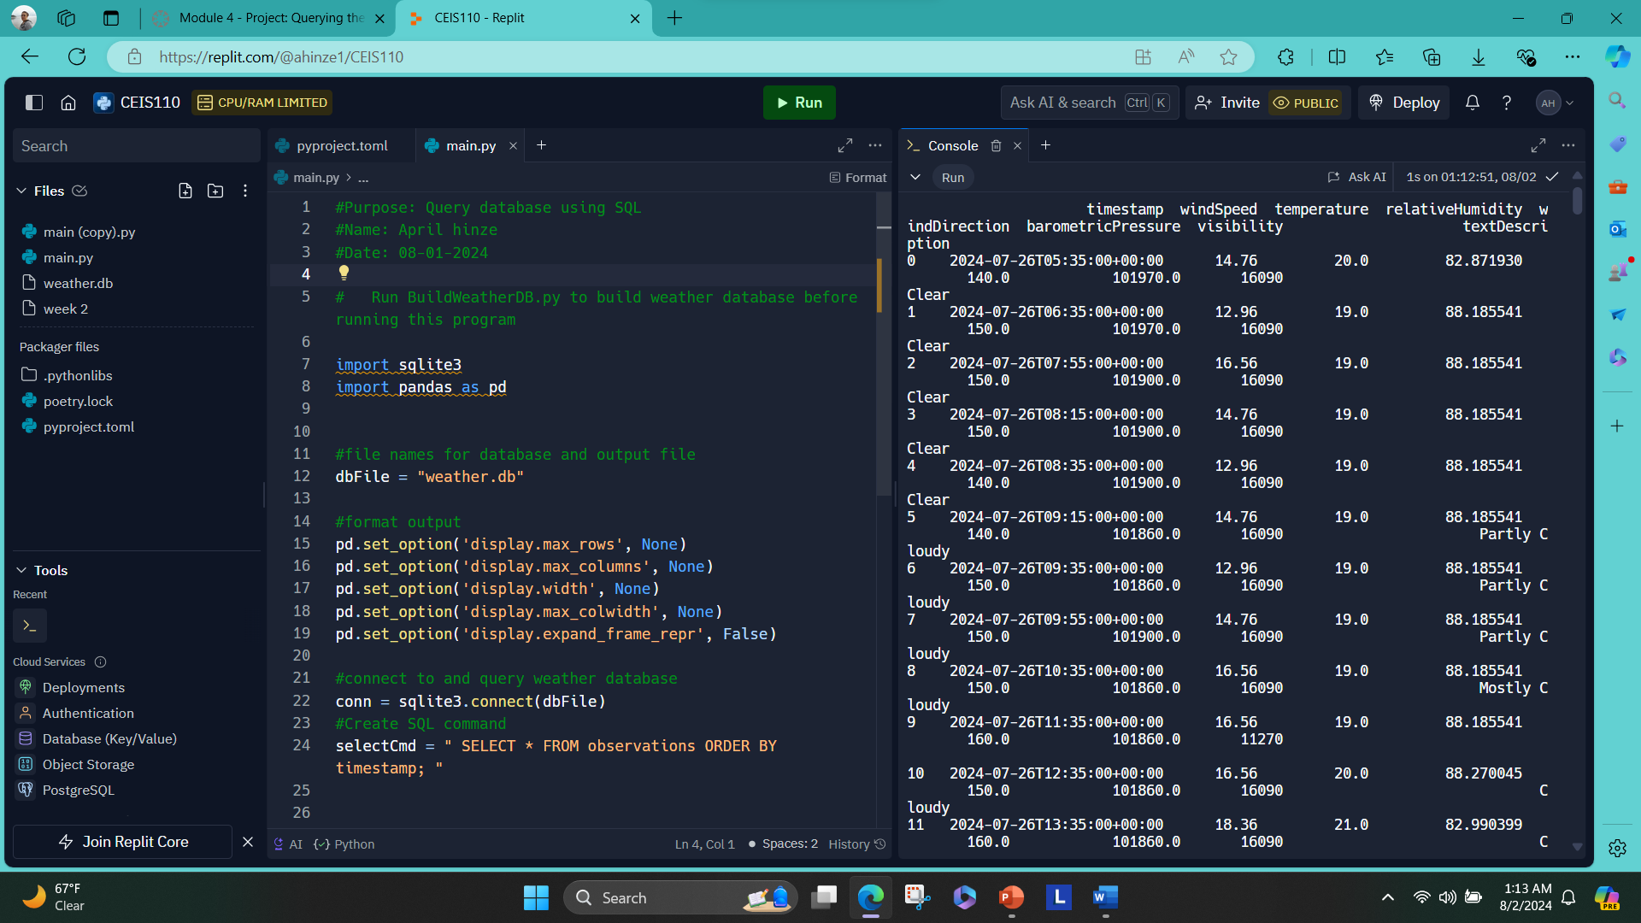
Query to retrieve all columns and all rows (Screenshot)
Screenshot of SQL query command and results

Slide 13
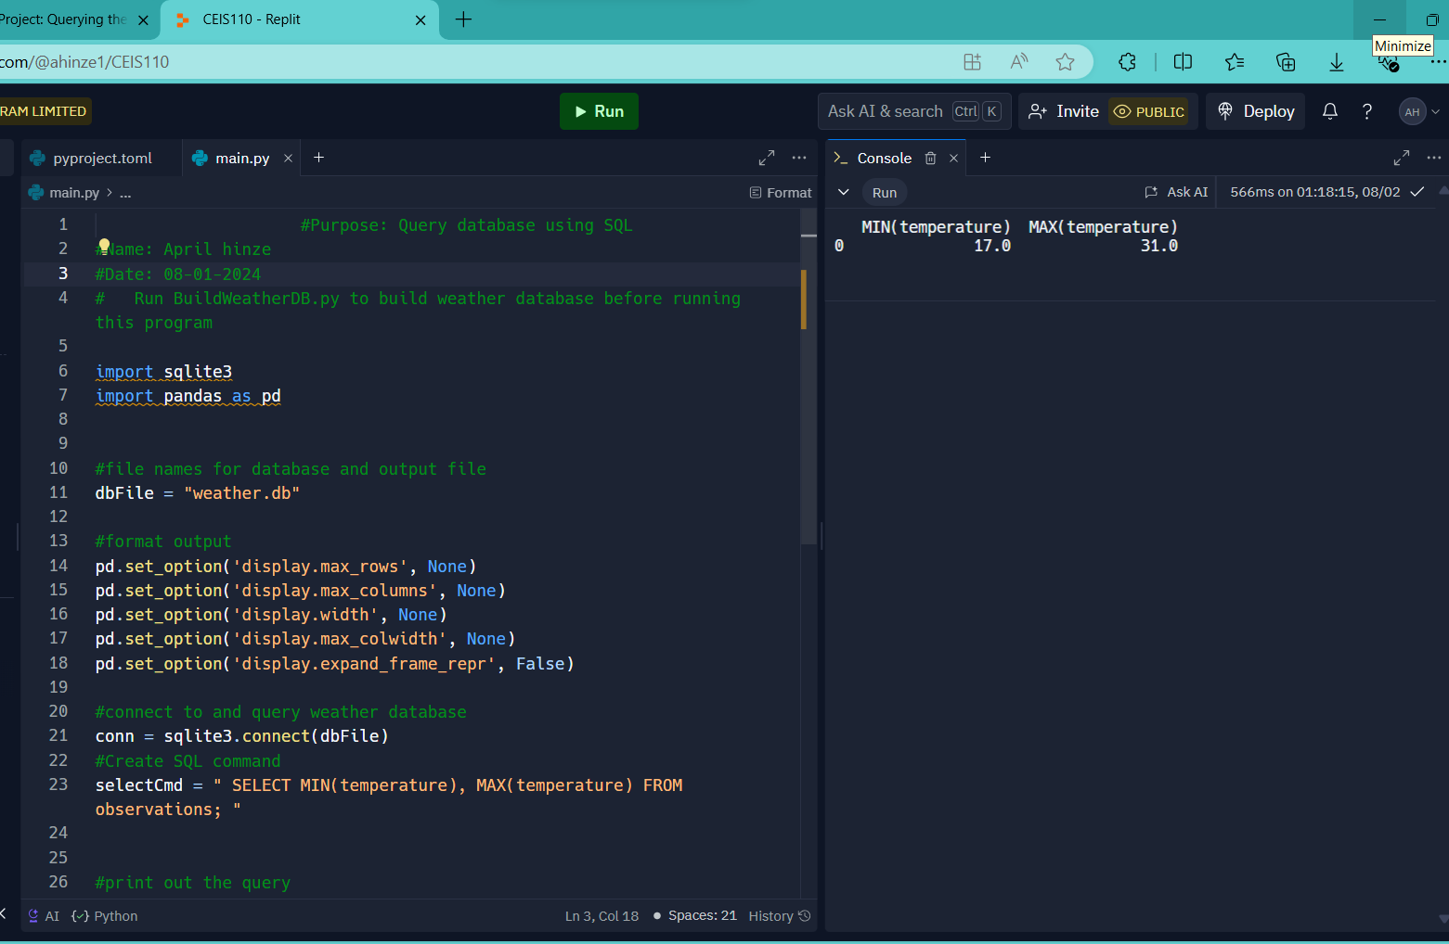
Query to retrieve lowest and highest temperatures (Screenshot)
Screenshot of SQL query command and results

Slide 14
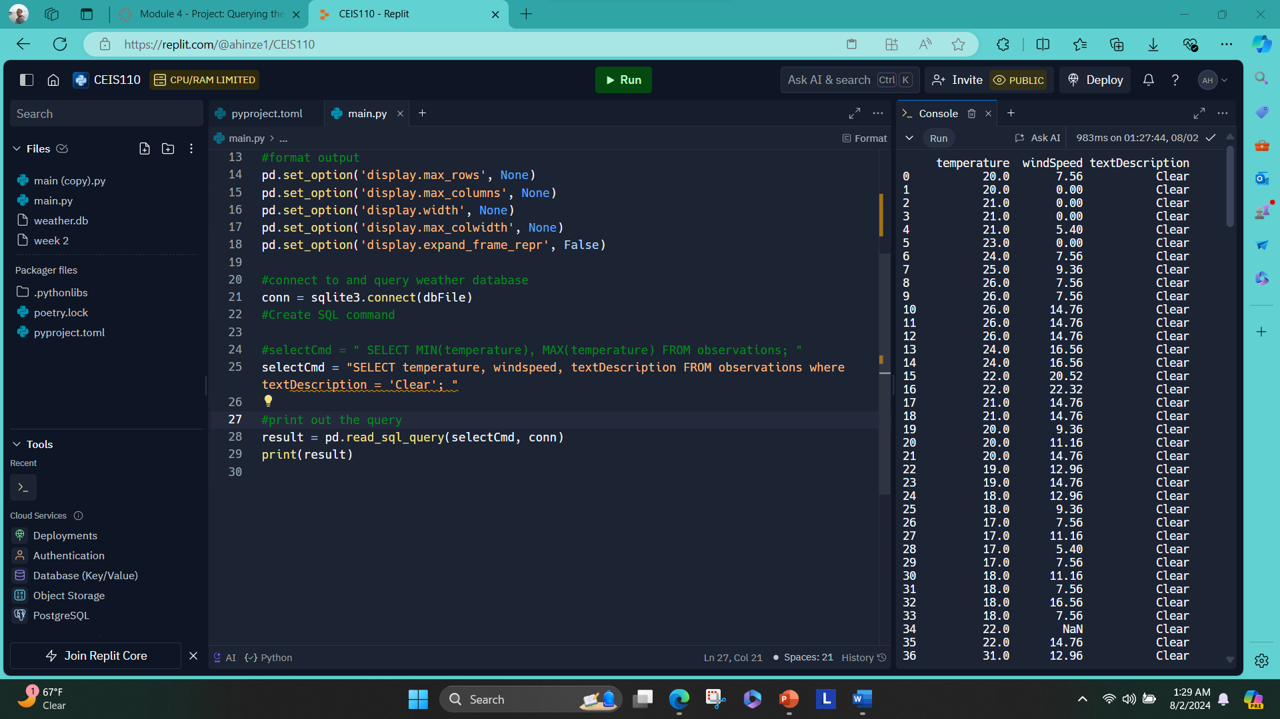
Query to retrieve all clear days (Screenshot)
Screenshot of SQL query command and results

Slide 15
Module 5
Extract Data and Analyze with Excel.

Slide 16
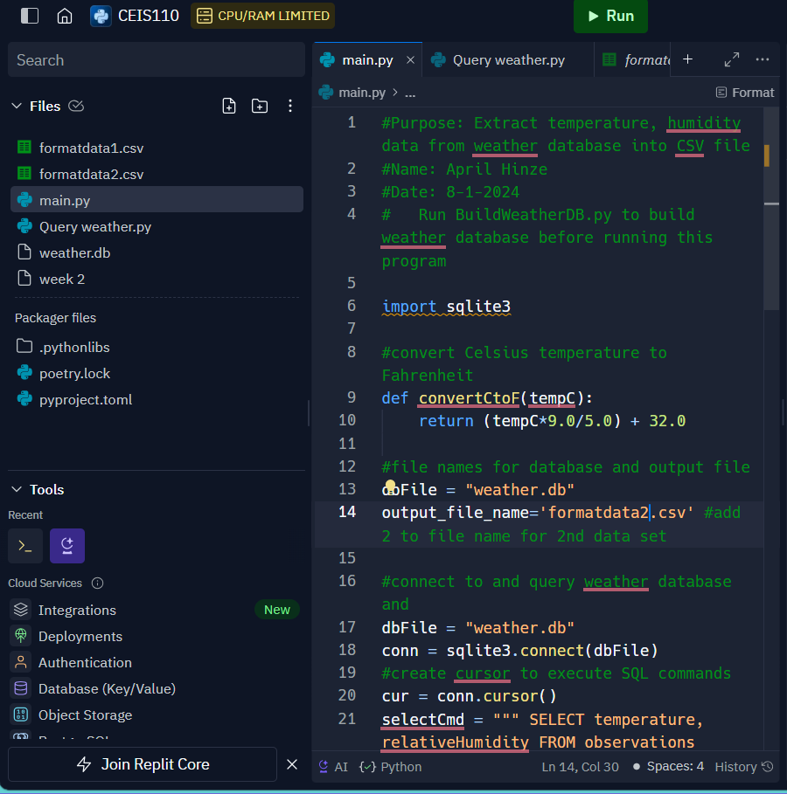
Python code (Screenshot or file)
ExtractTempHumidity.py Python code with your name and date in comments

Slide 17
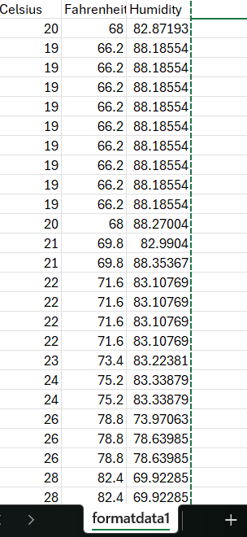
Retrieve and Convert Data to CSV Format (Screenshot)
Format data file open in Excel showing 3 columns of data

Slide 18
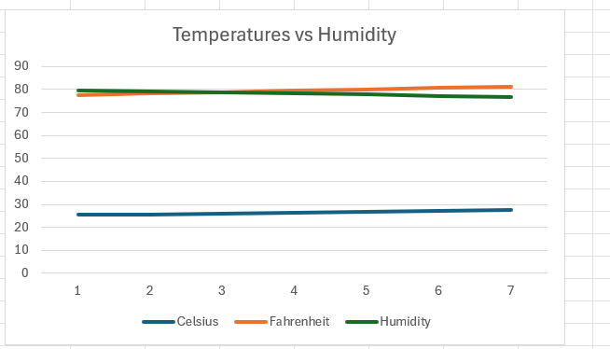
Temperature and Humidity Chart (Graph)
Excel chart based on temperature and humidity data from database

Slide 19
Module 6
Creating and analyzing Python charts and graphs.

Slide 20
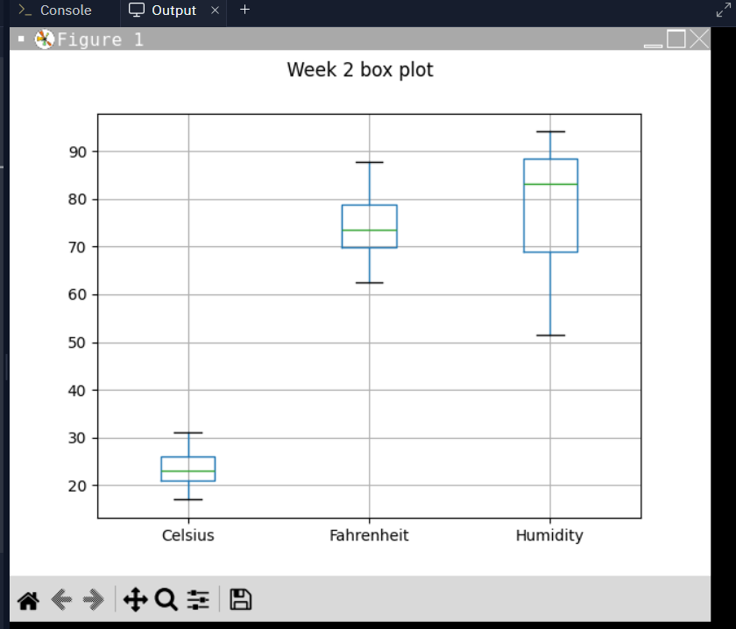
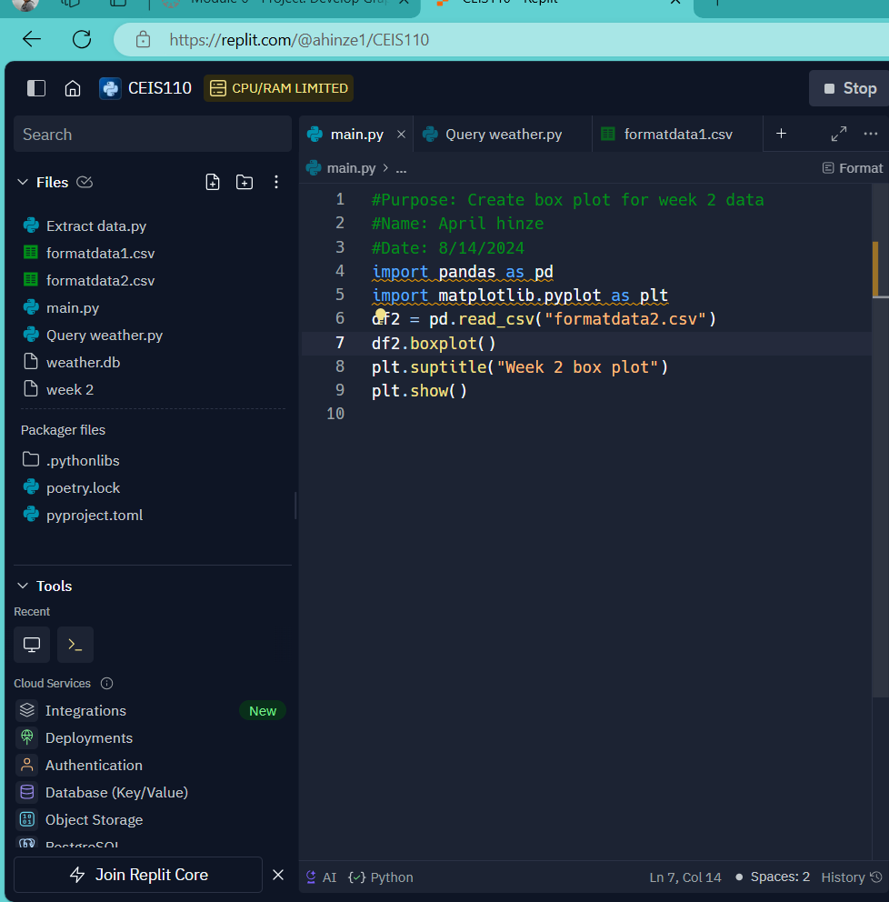
Plot #1
Plot and code used to generate it
Box
Line
Histogram
Scatter
Research your own!

Slide 21
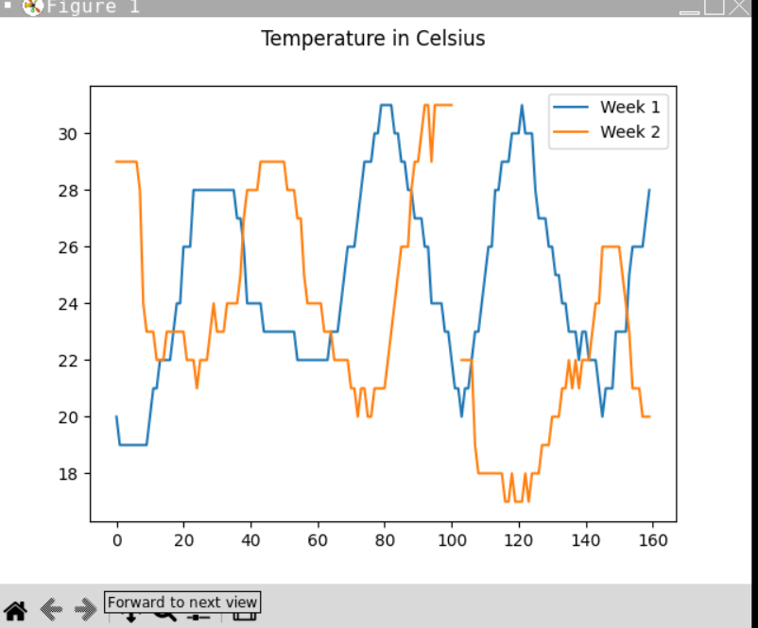
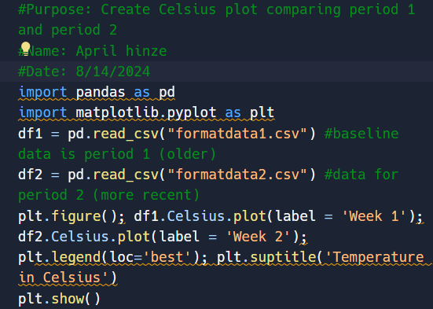
Plot #2 (Screenshots)
Plot and code used to generate it
Box
Line
Histogram
Scatter
Research your own!

Slide 22
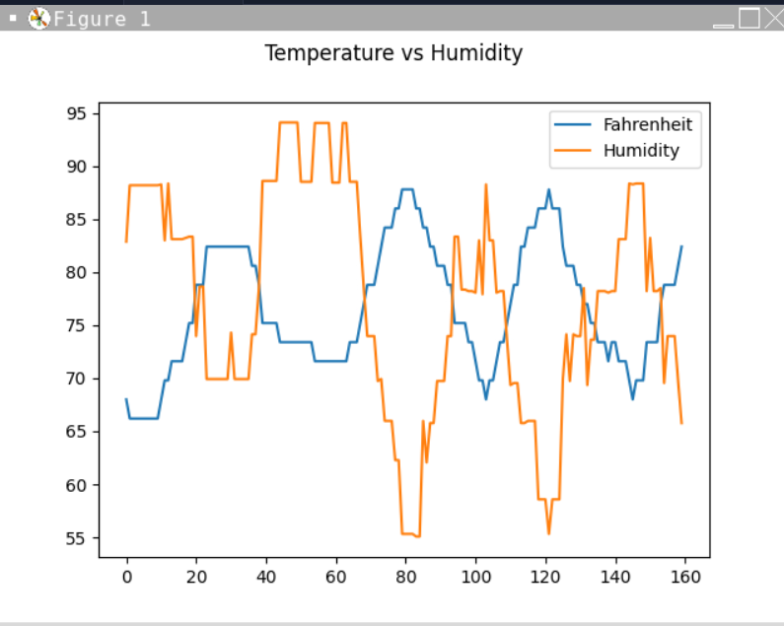
Analysis
Think of your own question and create a chart/graph to answer it
Your own question:
Is there a relationship between temperature and humidity?
Answer supported by Chart:
When temperature goes up humidity goes down vice versa.

Slide 23
Prediction
Develop a prediction based on the data. What variations in temperature and humidity do you expect over the next few hours or days? How would humidity change if the temperature goes up or down?
I predict that if the temperature decreases and the humidity increases, we may see rain and flooding shortly here in Minnesota.

Slide 24
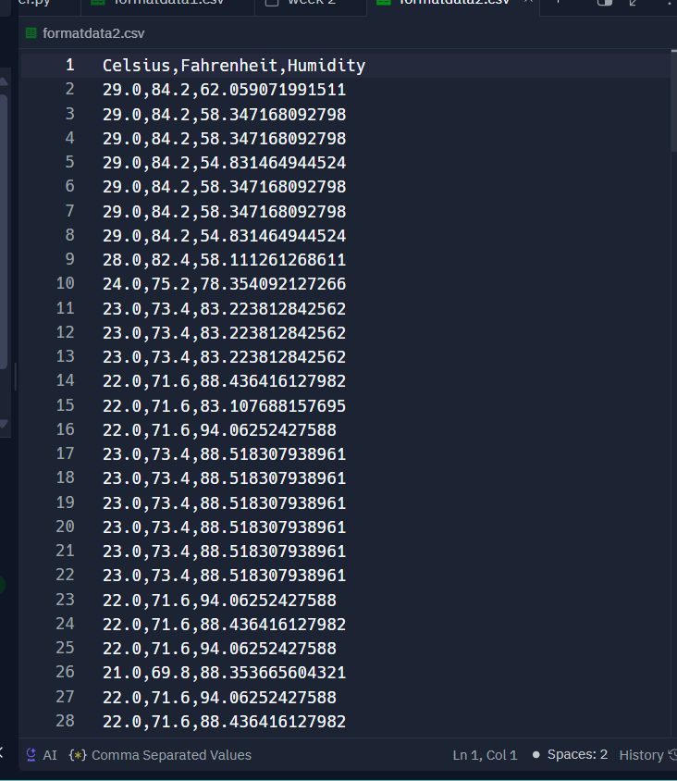
Formatdata2.csv

Slide 25
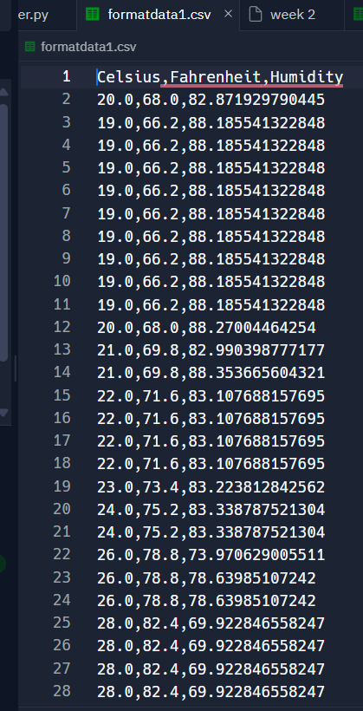
Formatdata1.csv

Slide 26
Challenges
Challenges were using Replit at first and understanding the weather data.
Learning to write code in Python and execute the code needed to be in the same directory as the weather. db.

Slide 27
Career Skills
Programming using python
it support
Coding and Networking
Communication
Analysis

Slide 28
Conclusion
This project covered the fundamental topics of programming with data by using data gathered from the cloud service to perform data analytics operations.

